Slide 1
Media Convergence,
A Deepening Crisis:
Time to Extend
Democratic Communication
Futures and Rights
Myoungjoon Kim, Mediact
Reflections on convergence
and media democracy in Korea
24 July 2015, Bangkok
Organized by Foundation for Community Educational Media
Notes:
한국은 지난 30년간 (1987이후) 급격한 정치적 변화, 미디어의 변화를 경험.
이 회의의 주제와 연관해서 보자면, 다채널과 융합 상황의 도래가 중요
다채널은 90년대 중반 케이블 TV의 등장.
융합은 90년대 중반 인터넷부터 시작
본격적인 논쟁은 IPTV로 시작. 이후 방통위 구성. 방통기본법 제정. 기타 융합법제 정비중.
(현정부 들어서 업무는 방통위와 미래부로 나뉘어짐 – 수많은 이슈들과 입장들)
오늘 발표는 이 과정에 대한 성찰, 그 성과와 한계를 점검하고 과제를 우리 맥락에서 제안.
Significant changes for the past 30 years in Korea
Concerning media, issue of multiplatforms and convergence was one of the major changes
Multi-channels : introduction of cable TV
Convergence : middle of 1990s Internet -> controversy regarding IPTV -> legislation on IPTV (2007) -> Broadcasting-telecommunication commission (Official English name is Korea Communications Commission, 2008) -> Basic law on Broadcasting-telecommunication (2009) -> to be continued...
Today’s presentation is to offer a reflection on this process, provide a briefing of outcomes and limitations, and offer a proposal on important issues that should be tackled during convergence policy and law implementation

Slide 2
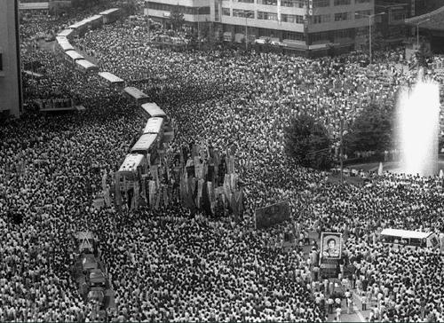
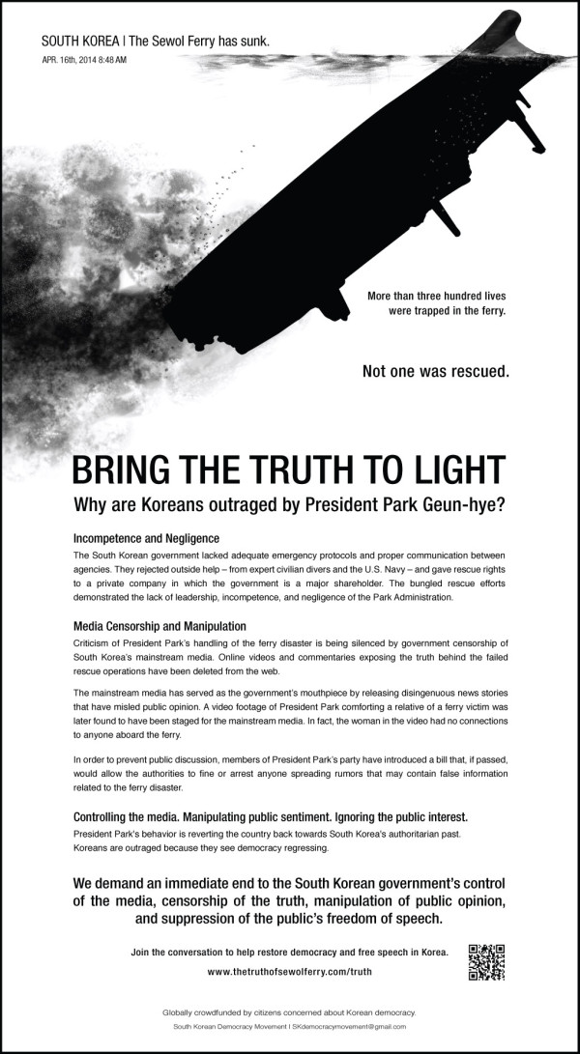
Prologue, South Korea:
outcomes, emergence and limits to democratic changes
1987-2015
Notes:
여기 두 개의 사진은 지난 30년의 역사를 압축한 것.
첫 번째는 민주주의의 도래를 가능하게 하고, 많은 공공적 정책들을 만들게 한 민중의 힘.
두 번째는 그러한 변화의 한계가 극적으로 노출되며 전체 사회의 문제, 특히 미디어의 문제를 극적으로 드러나게 한 비극적 사건에 대한 이미지. (세월호)
These two photos symbolize 30 years of contemporary South Korean history.
1st Image (left) represents People power which ushered in a more democratic society, and implemented many public interest policies.
2nd Image (right) is an ad taken out in the NYTimes of the tragic Sewol disaster which exposed Korean society’s structural problems, basically of safety and the role of the state, and at the same time the role of the media for the people (media coverage disaster).

Slide 3
Prologue, South Korea:
outcomes, emergence and limits to democratic changes
80~90
2000
2002
2004
2009
2012
2013
Birth of
media activism:
mainstream and alternative
Community radio
Media center network
New legislation:
Broadcasting and film
Seoul Maeul Media
Mediact launching
Extension of media centers and Maeul Media
Notes:
성과는 다양.
오랜 문제를 해결해가고 = 검열의 축소. 공영방송의 강화.
새로운 주체를 형성해가고 = 새로운 공공적 미디어 영역의 등장.
But Before talking about limits and problems, I will talk about some outcomes and emergences to convey the bright side of the story.
Outcomes: (significant) A decrease in censorship + An establishment of a public broadcasting system
Emergence: New models for public media systems including: public access, community radio, local media centers such as Mediact, and the formation of a local media center network
With fast developing technological advances in line with all these (previously mentioned) developments, media could help build a more democratic and participatory society.

Slide 4

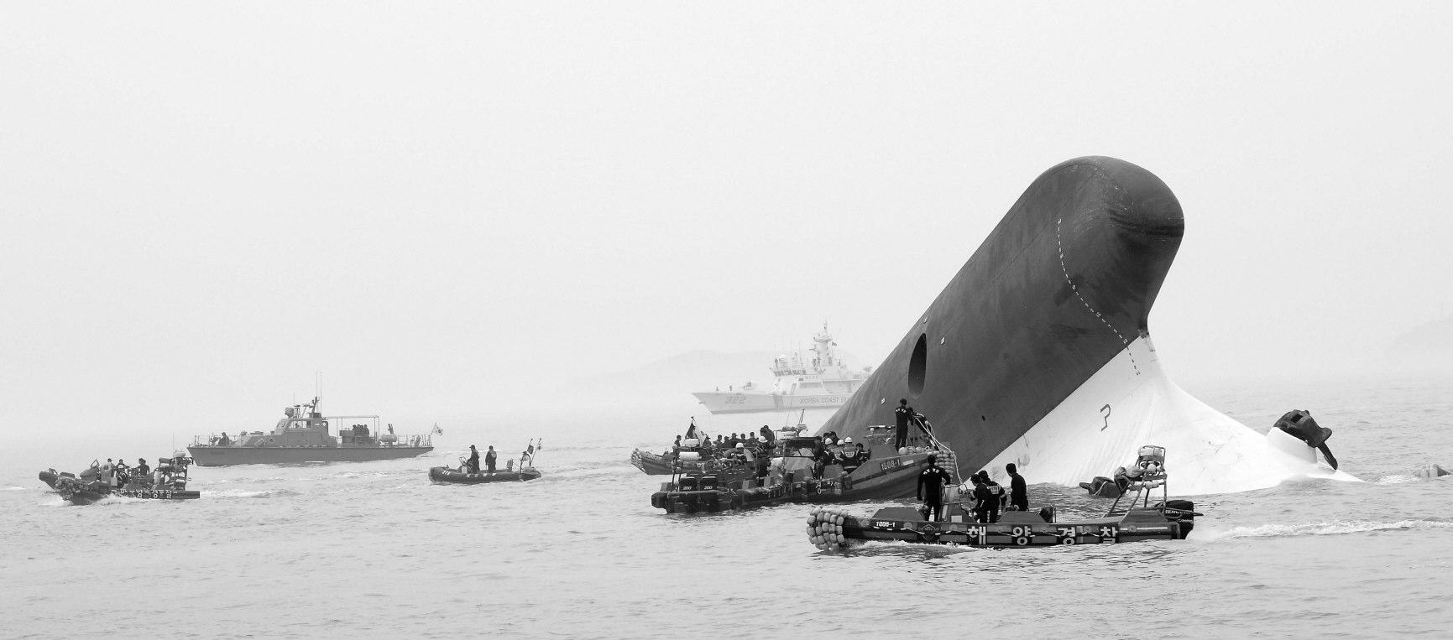
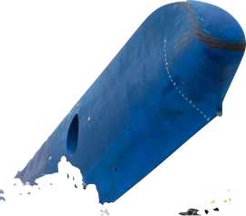
Prologue, South Korea:
outcomes, emergence and limits to democratic changes
2014-2015 Sewol-ho disaster
Notes:
그러나 한계도 뚜렷. (특히 지난 정부와 현정부에 있어서)
세월호 사례를 잠깐 살펴보면
주류미디어도 함께 침몰.
오보, 그리고 선정주의, 정치적 통제에 굴복한 미디어들.
-> 정부비판적 내용은 실종되고, 선정적 경쟁은 도를 넘어섬.
-> 주류 저널리즘의 붕괴
원인은 정부의 통제. 시장에 대한 항복. 전통적 규제 모델의 실패.
--> 융합 과정에서 많은 정책적 한계가 드러난 것
: 올드 미디어는 거버넌스의 붕괴.
: 뉴 미디어는 대안적으로 활용되나 지속가능성의 문제가 있으며
상업 미디어들은 한계를 드러냄.
--> 그렇다면 무엇이 필요한가 ? 우선 가장 근본적인 커뮤니케이션 시스템에 대한 철학부터..
But painfully enough, limits have also been made clear. And lessons must be gained.
Let’s go back to the sinking of ferry Sewol-ho accident.
After the accident happened, the mainstream media also sank down. (public media and private media altogether, with just a few exceptions)
Case : 2014 Sewol-ho media coverage disaster
Censorship in mainstream media regarding rescue effort,
criticisms of government’s continued neoliberal policies undermining public safety,
Also censorship of Ferry passengers’ family members requests for an investigation.
Why did these happen ?
Cause 1: government control of the governance of policy-making
and management of public media,
Cause 2 : market failure
(monopolization->market censorship + competition-> sensationalism)
And one of the important backgrounds for these are
Cause 3: limitations in broadcasting-telecommunication merging framework
(failure in establishing a media ecosystem promoting communication rights)
in other words, Old framework : top-down, the vague concept of public interest, no focus on communication rights and different model of independend and participatory media

Slide 5
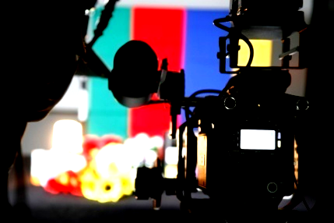
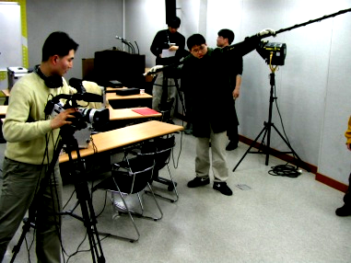
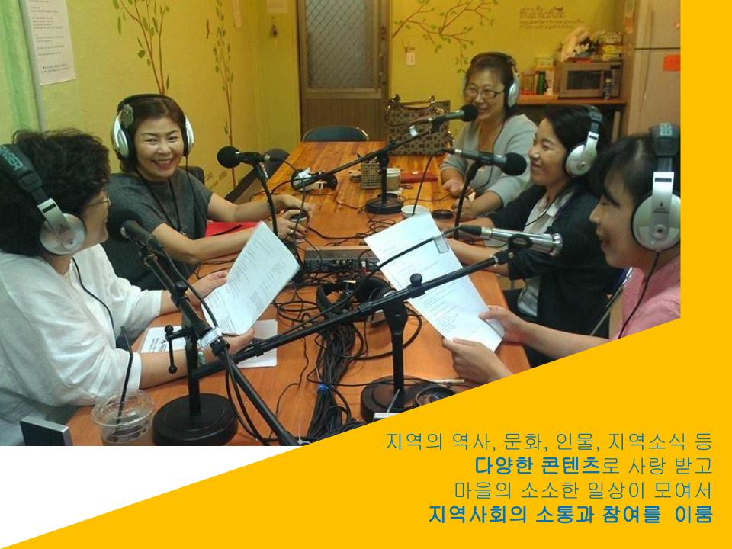
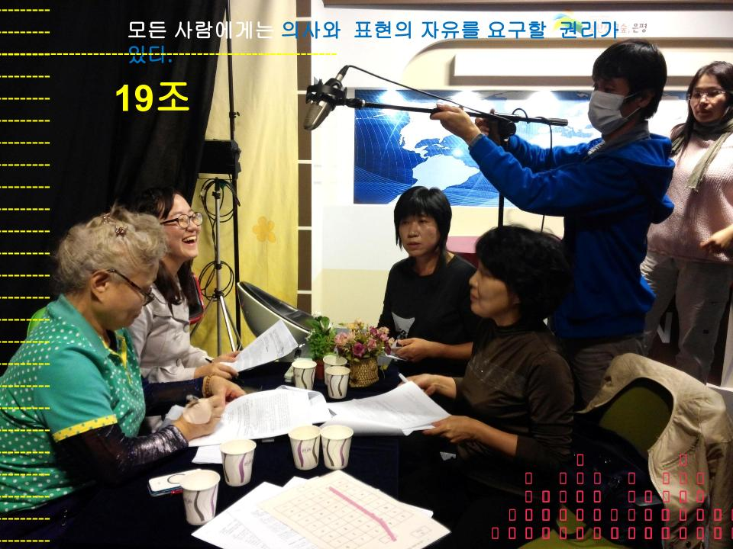
Fundamental convergence issues:
human rights, independent public interest media, local governance
Access Diversity
Participation and Expression Privacy
Media literacy Minority rights
Protection from unjust human rights violation
Notes:
미래 사회에 대한 인간중심적 전망의 필요성.
* 한계
올드 미디어의 일방향적, 계몽적 철학을 넘어서는, 기계적 쌍방향이 아닌,
국가기구들간의 이해조정에 초점을 맞추는 방통융합에 제한되지 않아야 함.
그리고 시민 참여, 독립 저널리즘의 확대를 반영해야 함.
* 지향
인권의 증진 + 민주적 미디어 생태계의 구축 (사적 이익, 국가 이익이 우선이 아니라)
+ 공동체 미디어/독립 미디어의 법적 보장과 진흥
* 예
- 방통기본법 초안의 내용 : 공공복리의 증진과 7대 권리 (항목 생성의 성과)
- 남미의 33% 전략 - 공동체에 대한 33% 주파수, 채널, 자원 할당 (아르헨티나 등)
So, the first proposal, or the fundamental point for implementing a convergence policy framework is seemingly philosophical, but actually concretizes the entire purpose of our media and communication system--how we define, regulate and promote it.
Fundamental convergence issues:
human rights, independent public interest media, local governance
A framework for the future that is human (rights) centered
- to overcome the prevailing non-interactive, top-down, market centered framework
- to move beyond the confines of government’s internal interest arbitration
- to promote human rights
--> Rights + Model of the media
Case 1 : site where we wanted to implement change in
Broadcasting and Telecommunications Basic Law (failures and ongoing issues)
→ 1. Moving in the direction of public interest
→ 2. Ensuring the following 7 basic (media) rights must be guaranteed by the state:
Access
Participation and Expression
Privacy
Diversity
Media literacy
Minority rights
Protection from unjust human rights violation
Case 2 : 33% allocation strategy (Latin America)
frequency, channels and other resource allocations for community media
Many countries are gradually adopting a three axes of media model, and some are putting forward a more advanced percentage model, for example 33%
These should be clearly announced and imagined with the public. The state should prepare a concrete plan for realizing these rights and new models of communication... We fought for these but failed (our main gain was the government agreed to make a chapter on public interest, but did not include specific concepts such as these 7 rights), and I hope to see those of you here succeed.

Slide 6
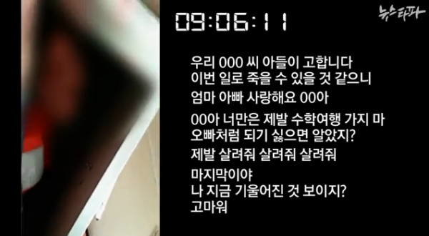
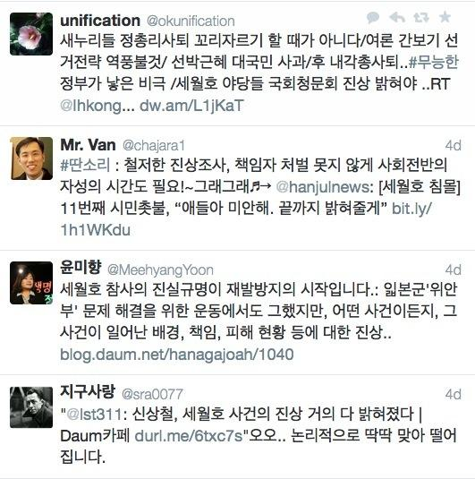
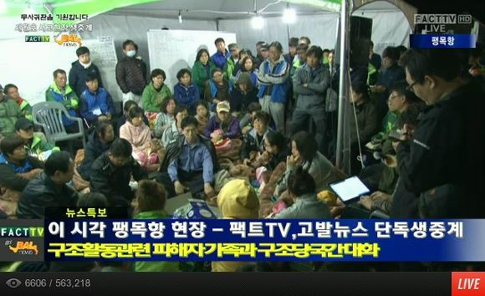
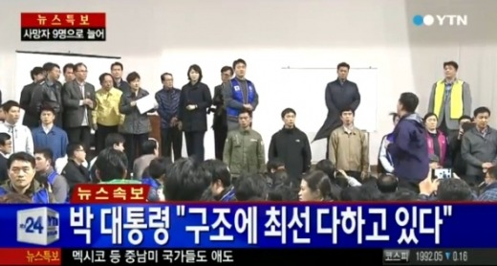
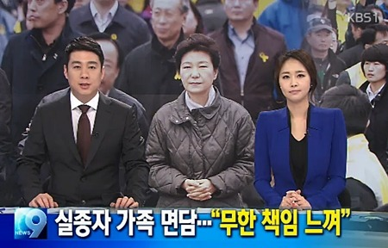
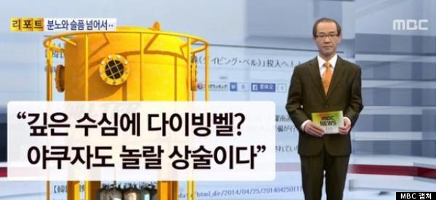
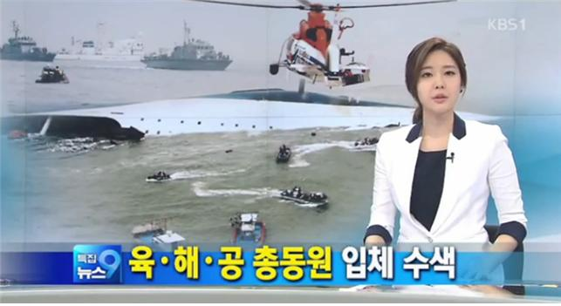


Promotion of independent media and community media for public interest
SNS
/ family media team
Independent media
Mainsteam media
Notes:
다시 세월호로 가보면,
주류 미디어에 환멸을 느낀 시민들은
1, 대안적인 전문적 저널리즘, 독립적 콘텐츠를 수용하거나
2, 스스로 미디어가 되었다. (416 가족 TV 유튜브)
* 전통적 공공성 프레임워크에 기초해서 설명하자면,
공영방송의 혁신과 함께, 공영방송의 유지를 넘어서는 문화(산업)생산 주체의 필요성
* 두가지 콘텐츠의 진흥이 요구된다.
A, 독립 콘텐츠의 진흥
: 시장을 통한 상업적 1인 미디어, 프리랜서 미디어의 진흥과는 다른 차원에서,
사회적 이슈와 그 극복, 그리고 예술적 실험을 지향하는 독립 미디어 콘텐츠 진흥
--> 시장을 넘어서며 시장을 형성한다.
B, 융합형 마을 미디어에 대한 지원 (주체 + 콘텐츠 + 플랫품)
: 시민들에 의한 자기표현과 소통, 이미 융합을 몸소 구현하며
시장과 국가가 제공하지 못하는 커뮤니케이션 시스템을 스스로 구축
--> 소비의 주체이자 생산의 주체로서 시장의 주체이자 시장을 넘어선다.
The next level of analysis is about the various modes and agents of producing and sharing content, and emphasizing what or which model or who we are talking about. The case which has made it clear that there should be an emphasis on something beyond the traditional form of mainstream media is again the ferry sinking disaster.
Promotion of independent media and community media for public interest
in Sewol-ho case, people either:
1. consume media by professional independent media makers
or 2. become the media by themselves.
These can be translated easily into two different sectors of media within a policy framework:
a) Independent media
critical, investigative and experimental
outside the market, foundation for the market, and building markets
B) Community media
convergence media comprised of people’s expression and modes of communication
building people’s multi-platform media system and communities
comprising the market, owning the market, and beyond the market
Platforms can be public, commercial or community owned, but the importance should be placed on the existence of media makers, and on creating favorable policies promoting people’s activities.

Slide 7
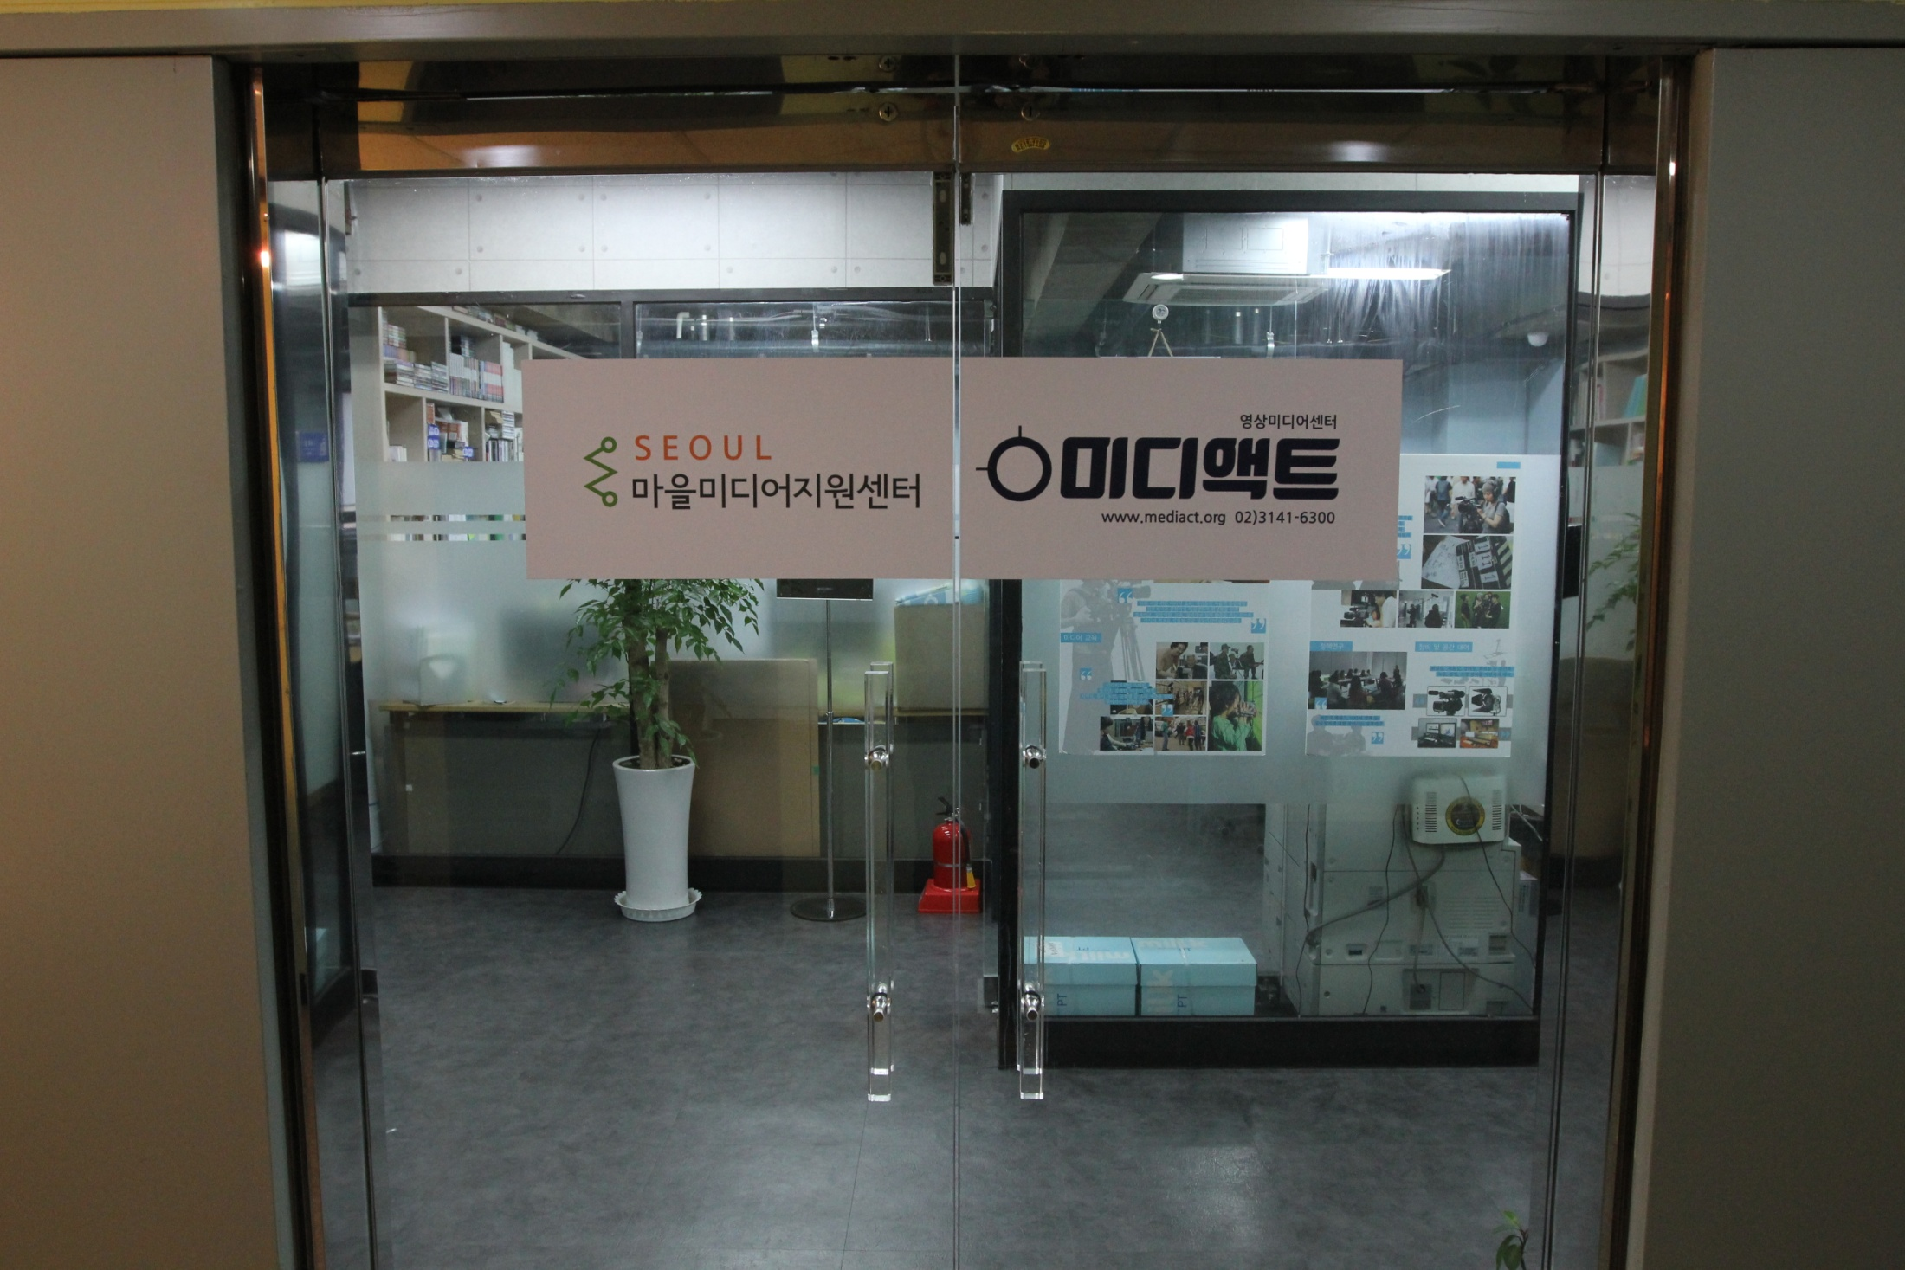
Promotion of independent media and community media for public interest
Notes:
7-11
* 예
미디액트
– A+B의 인프라 : 교육/지원/컨설팅을 통한 주체의 양성과 정책의 생산
2002년 이후 10만명 이상의 시민, 독립제작자에게 서비스 제공.
(3만명 상설강좌, 기타 공동체 미디어 교육, 마을미디어 교육 등 포함)
A first example I want to share combining both the sectors of A independent and B community media within a policy framework is
Mediact.
Mediact was established in 2002, in the central area of Seoul City. It was formerly a state funded non-profit, but is currently an independent non-profit with a variety of funding sources.
Briefly speaking, Mediact has been active in promoting both independent media and community media sectors.
Here in this image, these two names seen together on our door symbolize our status.
On the right you can see our name and it references a whole range of activities such as: promoting A+B through education, consulting, supporting, networking and policy research.
Another on the left is the significant focus we place on community media and the work we do in the name of “Maeul Media,” which I will elaborate on later.

Slide 8
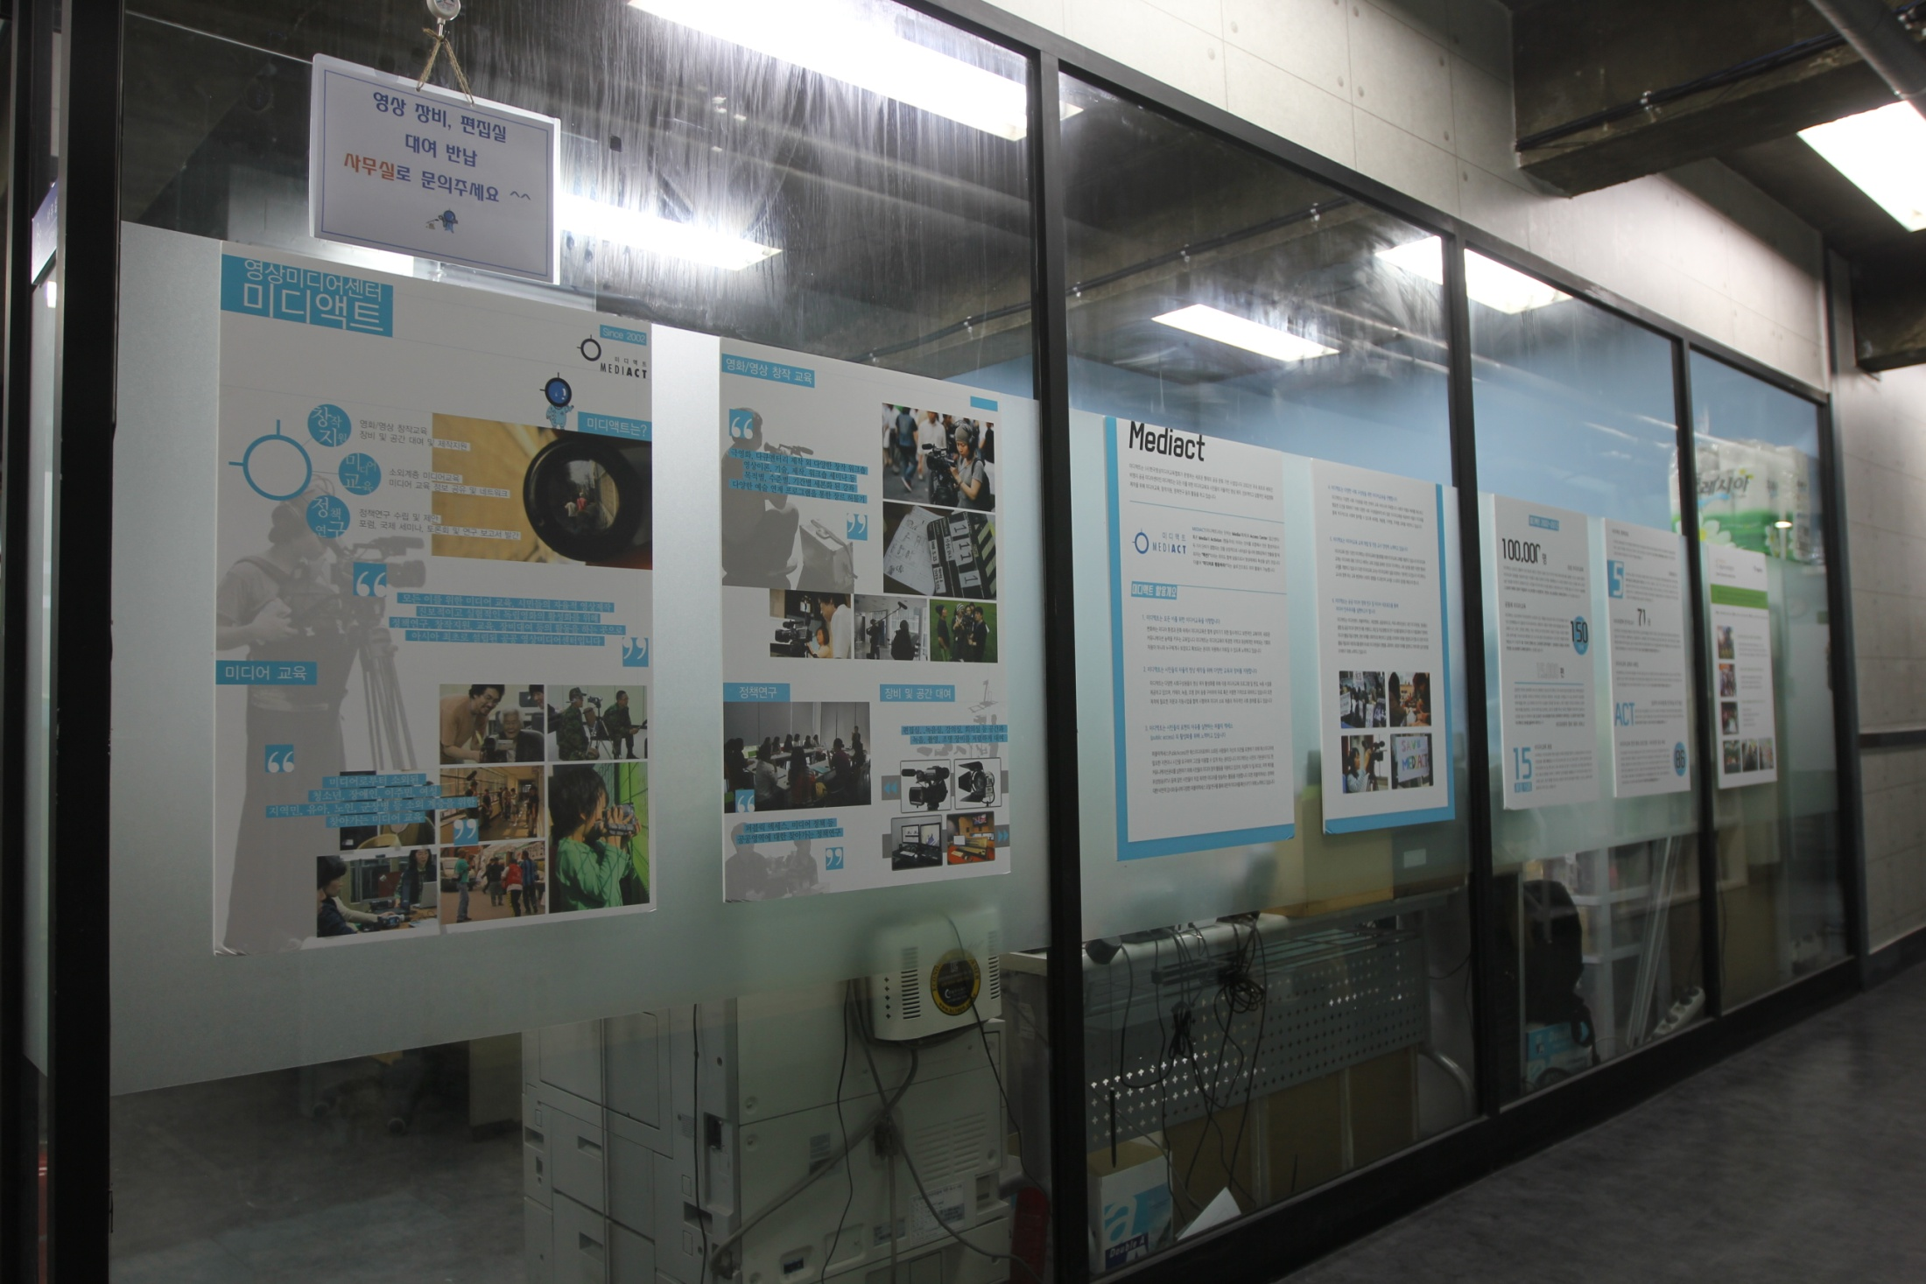
Promotion of independent media and community media for public interest

Slide 9
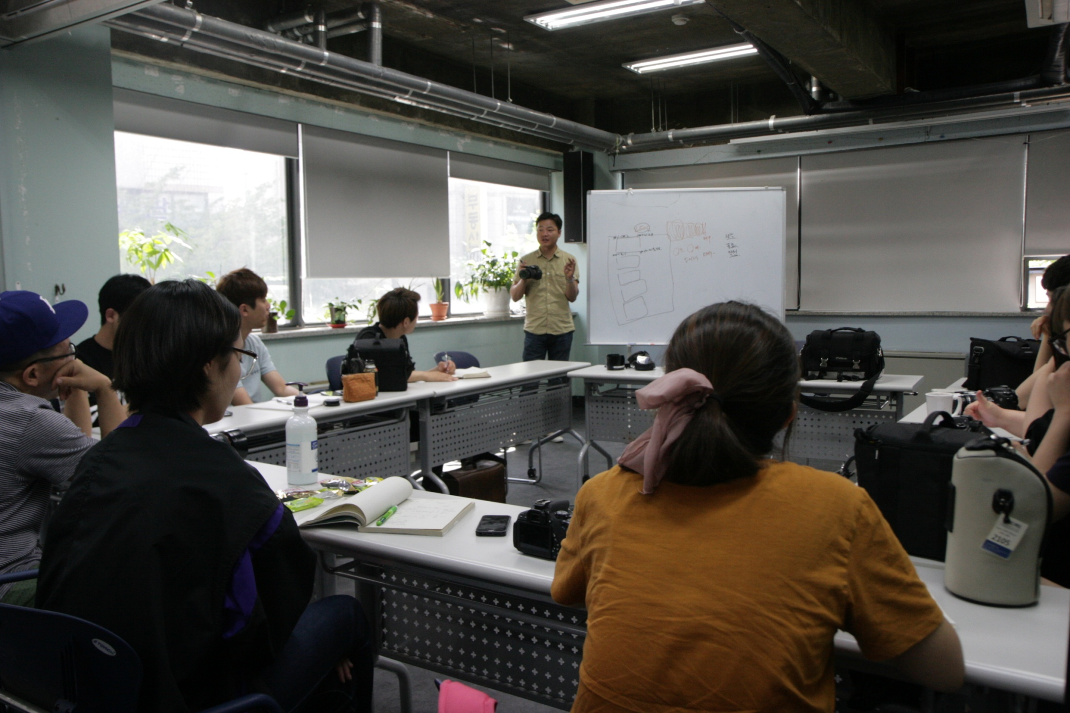
Promotion of independent media and community media for public interest

Slide 10
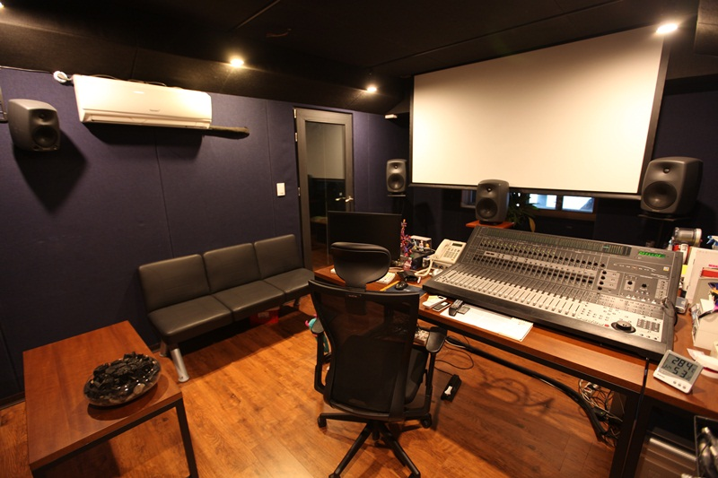
Promotion of independent media and community media for public interest

Slide 11
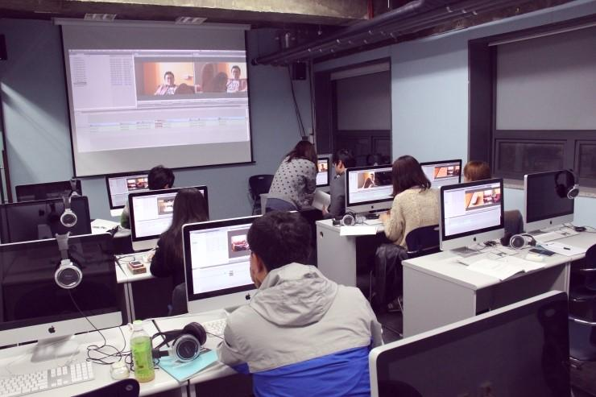
Promotion of independent media and community media for public interest

Slide 12
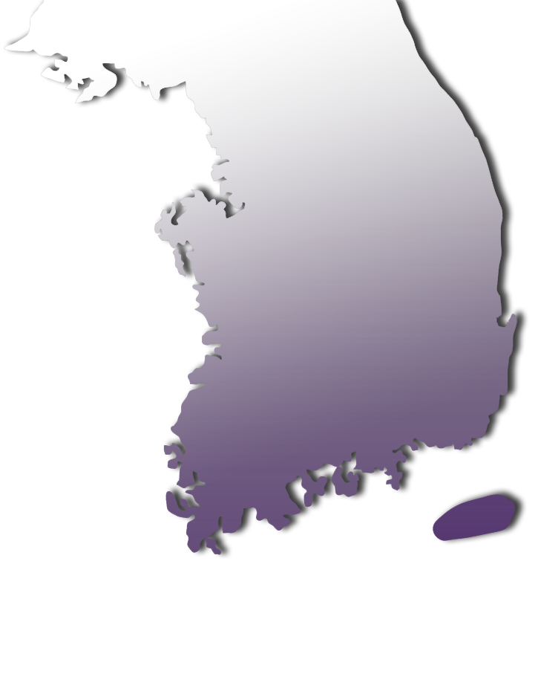
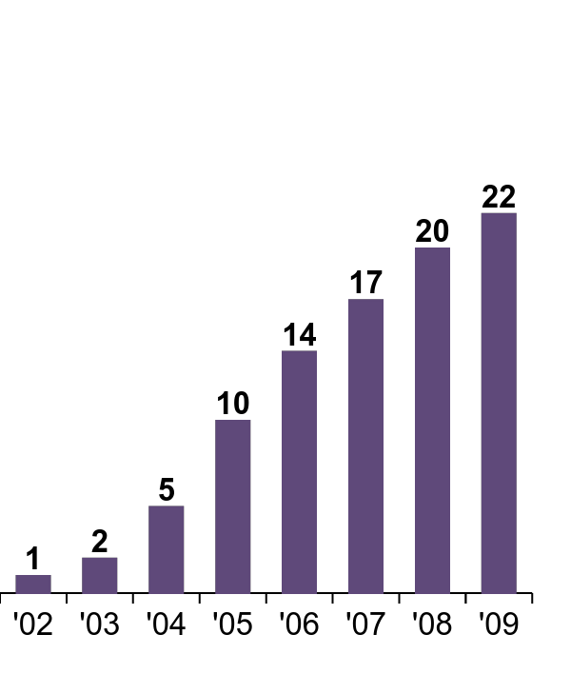
Localism, or
local people’s media ecosystem
Notes:
12-13
--> 현재 전국적으로 30여개 미디어센터
: 여기서 우리는 세 번째 주요한 과제로 지역성을 언급할 수 있다.
지역중심성, 지역주민의 자치와 주권
Since we started, we and many local activists have spent tremendous energy implementing a similar infrastructure for media making in other cities of Korea. And now as of 2015 there are more than 30 local media centers.
As you can see, a network has grown steadily, and even after 2009 when the last government regime launched and developed a hostile position to citizen’s empowerment projects like these, activity has not ceased and under the current government, the infrastructure and network are still growing.
And also you can see here, an emphasis on independent media and community media are inseparable, and an emphasis on people's rights are strongly interconnected with the issue of locality.

Slide 13

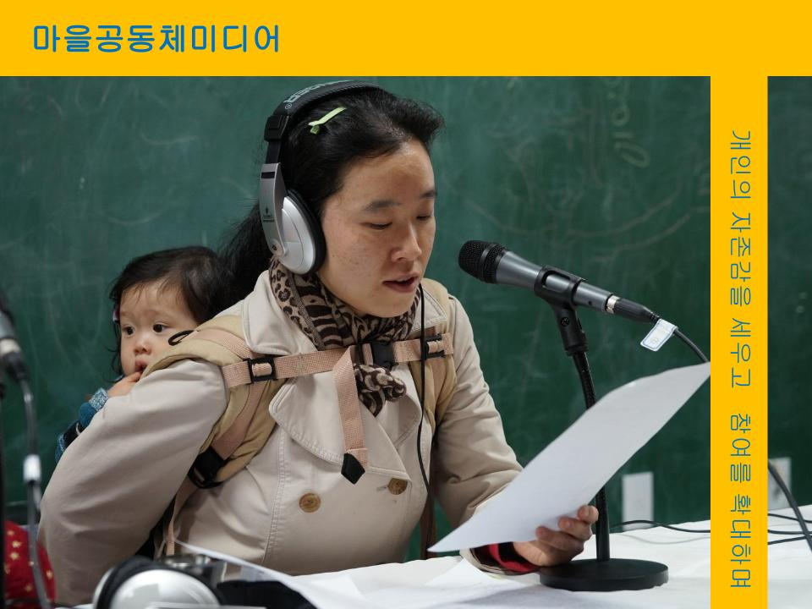
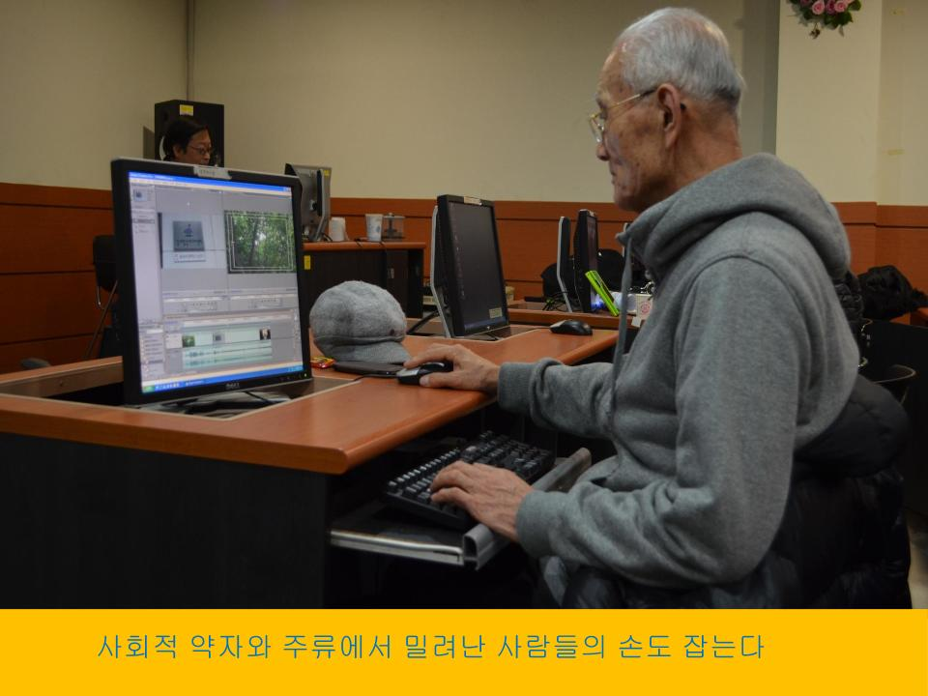
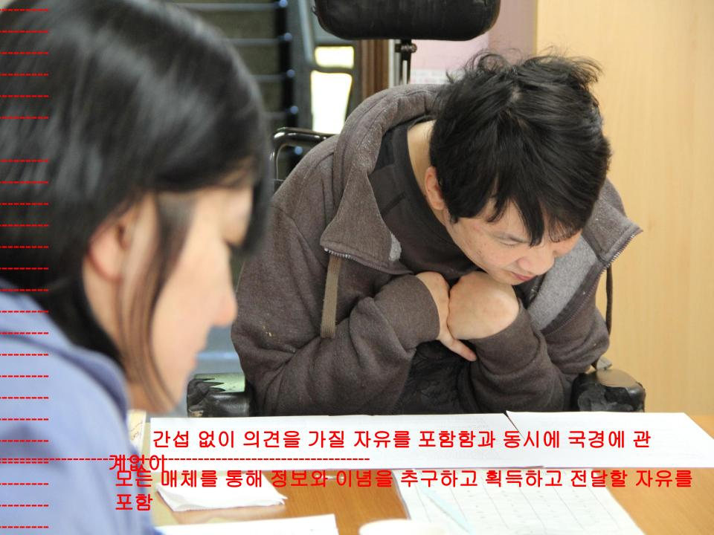
Localism, or
local people’s media ecosystem
Notes:
* 한계
수도중심적, 획일적 정책 프레임과 자원 배분을 넘어서기
* 지향
지역 미디어 시스템의 생산적 시장 형성 및 지역 담론 활성화
= 독립 미디어와 공동체 미디어 중심 구조 + 공영 미디어와의 협업
So, I would like us to consider together issue of geography pertaining to stewarding a media policy framework and forms of localism
or a local people’s self-governance media ecosystem.
What can we do to work together to:
Overcome a capital-centered, megacity-centered policy framework and resources
Establish sustainable local media markets and communication infrastructure
Thrive within an ecosystem of independent media + community media centers with strong bonds with local public broadcasting systems

Slide 14
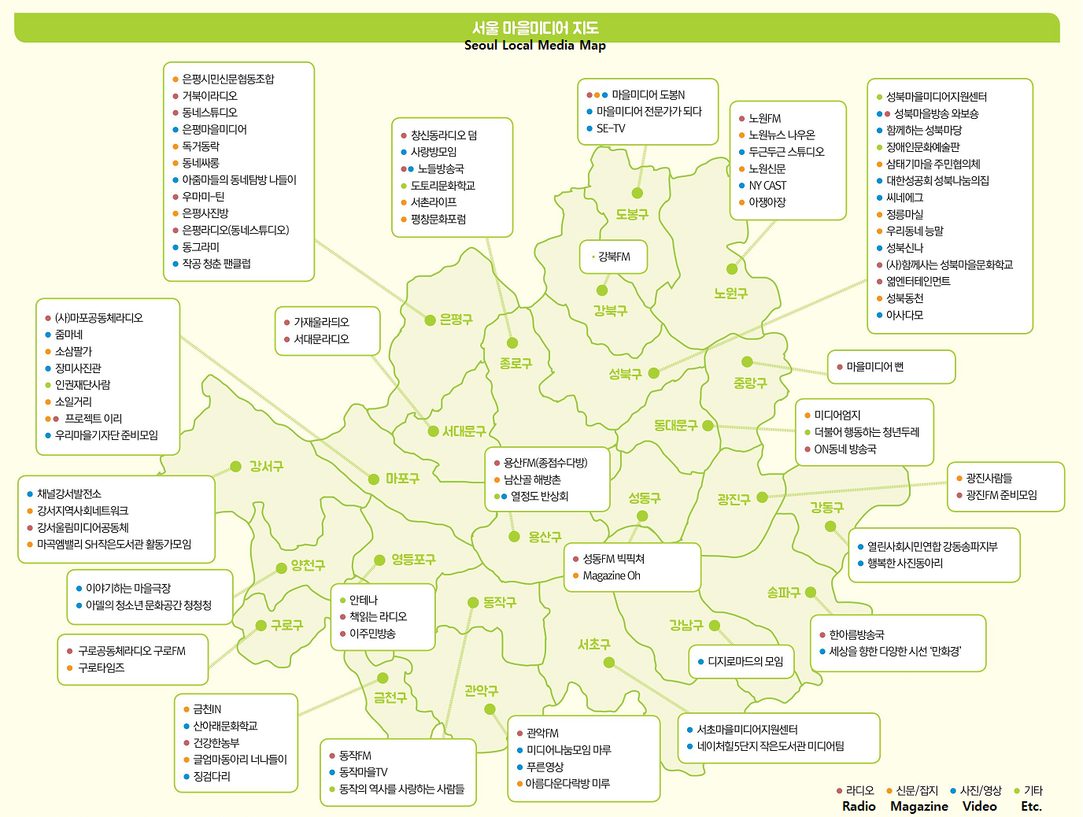
Localism, or
local people’s media ecosystem
Notes:
공동체 미디어이자 지역 미디어의 주요한 영역은
서울시 마을미디어
지도를 보면, 현재 100개에 가까운 시민 그룹들이 서울시 전역에서 활동중.
이들은 고립된 개인이 아니라 지역 공동체와 융합되어 있는 네트워화된 개인들.
– 서울시 + 전문가그룹(미디액트) + 시민의 협업 모델
--> 공적 지원 + 촉매제 + 자율적 시민의 형성의 융합 (Converging governance)
* 한 참여자의 표현 “우리에게 마을미디어는 ‘숨’입니다.
당연히 행해져야 할 것이고, 필요한 일이고, 숨통 트이는 일이 아닐 수 없습니다.“
(씬블리 강북FM)
Now we go back to “Maeul Media” which we just took a glimpse of from the Mediact office doorway.
Maeul media is our best praxis case for community media + local media.
Seoul Maeul Media/
is a local community-based city-wide people’s media project
-> This is amap of Seoul. There are almost now 100 groups working together with Mediact, based on fiscal support from Seoul City.
→government support + professional civic catalyst +citizen/local resident ownership
=a model of converging governance
-> to rearticulate some of Maeul Media features, it is: new, multi-platform, based on needs, community media + local media praxis
-> “citizens’ breaths” ( one participant has expressed “maeul media” which can be translated as village media as we create many villages or communities within a city is better interpreted as media can create the breathing space for people living in a city)

Slide 15
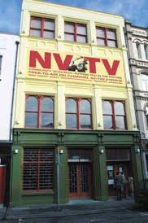

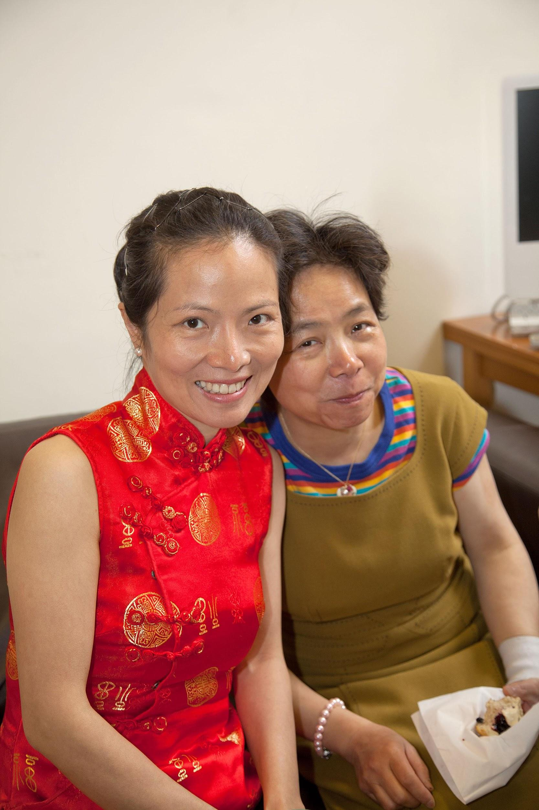
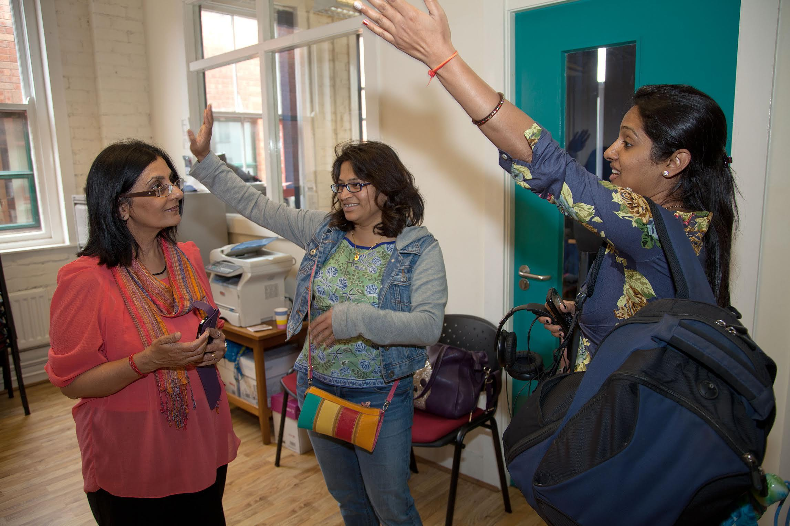
Localism, or
local people’s media ecosystem
Notes:
* 국제적 예들은 무수히 많다.
각국 공동체 TV, 라디오의 사례들인데...
이 이미지는 영국 HD 지역 방송의 사례. 지역미디어센터인 노던 비젼이 운영.
주파수 지역 할당, 비영리 주체의 운영, 직접 지원 및 공영방송의 지원.
Comparative Case: NVTV, local HD broadcasting systems in UK
Comparative Cases around the world are numerous: Especially in regards to funding structures for community TV and radio systems
One case I would like to highlight that we have learned from over the years is from our colleagues at NVTV in Belfast, some of you may already be familiar of it as a media center running a HD local TV channel. We recently interviewed NVTV’s Marilyn Hyndman about their work, and you can find out more about it in our online magazine (ACT published in Korean and English).
source: http://actmediact.tistory.com/236
열정 가득! <여정 그리고 정착> 프로젝트를 함께 만들고 있는
벨파스트 지역 예술가 모임 아트엑타 사람들의 모습.
<여정 그리고 정착> 프로젝트는 인도, 중국, 이슬람 국가에서
벨파스트로 와서 살고 있는 여성들과 함께한다.

Slide 16
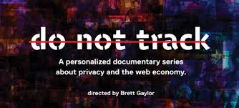
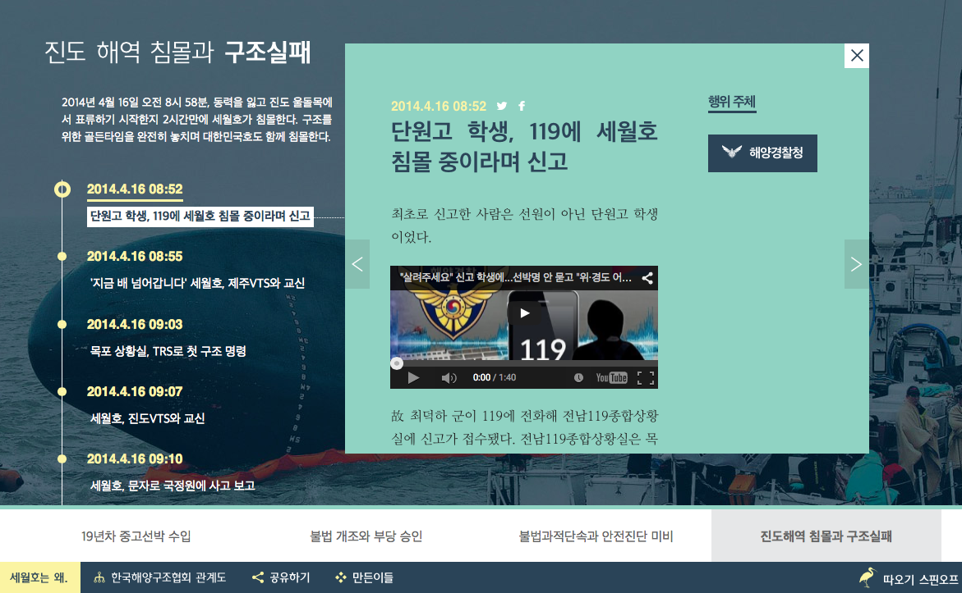

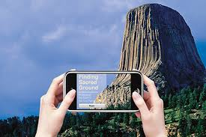
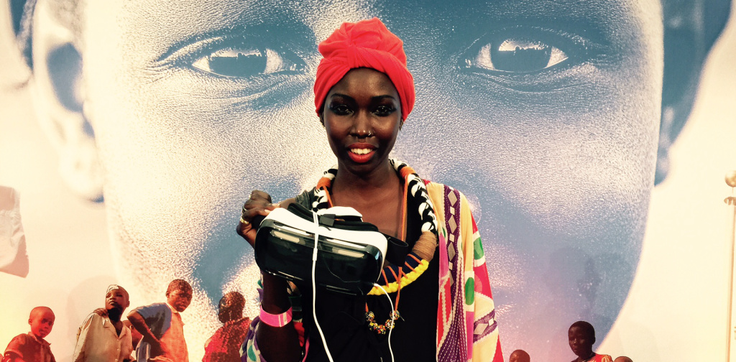
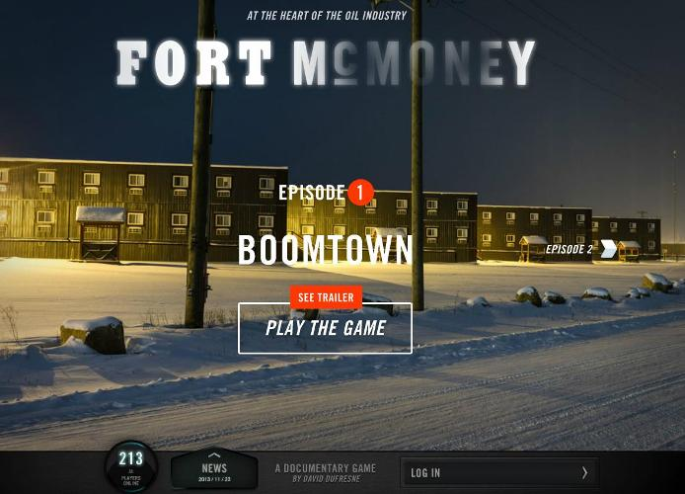
Challenges beyond traditional media:
Transmedia, VR, AR, and other virtualities
Notes:
네 번째는 새로운 미디어의 실험들.
넓게 보면, 트랜스 미디어부터 쌍방향 스토리텔링, 드론, 오픈소스 소프트웨어와 하드웨어의 활용, 3d 프린터에 이르기까지 다양한 미디어 및 인접 영역의 기술이 급속하게 발전하는 상황
다른 맥락에서는 새로운 세대의 콘텐츠 생산자이자 소비자인 주체가 등장 (매드맥스에 오리지널이 있다는 것을 모름 - digital native audience의 등장), long form linear storytelling --> short form nonlinear storytelling 등 변화는 전방위적.
미디어의 입장에서 보자면, 경계 파괴에서 출발해서 새로운 영역의 창출이 이루어지는 상황.
산업, 문화, 커뮤니케이션의 발전을 위해서는
시장을 형성하면서, 시장의 실패를 넘어서는 프레임이 필요
- 산업적 프레임을 현장의 수요, 시민의 필요, 독립/마을 미디어 생태계와
연결시키는 실험을 공공적으로 지원해야, 민간은 적극적으로 실험.
The Fourth issue I would like to talk about is regarding policy framing for a cutting edge area of new media practices that comes in many names and many forms. Here I titled it as....
Challenges beyond traditional media: Transmedia, VR, AR, and other virtualities
The question is like this
What connections can be made with technological experimentation beyond the traditional media frame
linked with needs and demands of ordinary people, independent media and community media?
The promising emergence of these as a field with examples from multiple localities demonstrates a need for changing traditional public interest policy frameworks towards the promotion of independent/community media + new media experiments based on a rights extension framework.
Cases
: Convergence of both linear contents and nonlinear audience interaction (NFB/ARTE)
: Timeline based storytelling / crowd sourced information (Jinbo Net)
: Hackathons for transmedia documentaries, etc.
: Augmented Reality created by media centers (BAVC)
: Public Interest VR (UN)
: Game + documentary (NFB)
--> Since our Future is not yet determined, facilitating intervention and experimentation now is of great importance.

Slide 17

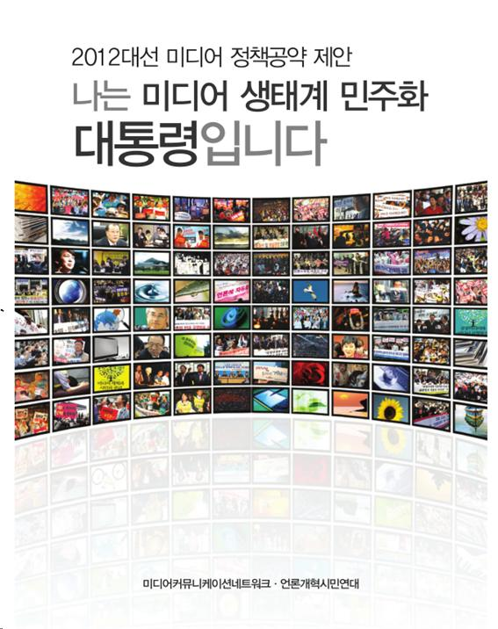
A democratic governance system
1. 전담인력 지원!!!
講座満足度
2. 미디어 제작 장비 지원!!!
3. 미디어 활동 공간 지원!!!
4. 민관협력 거버넌스 강화!!!
2002 2005 2009
Notes:
마지막으로 거버넌스 시스템의 구축.
아무리 수사학이 많아도 구현 과정 = 제안, 입안과 결정 과정의 민주성, 투명성이 중요
* 한계
국가 주도 의사 결정, 행정 권력의 주류 미디어 장악 보장을 넘어서기
* 지향
정책 협의와 결정 과정에 대한 시민의 참여
이를 위한 시민적 governance 구조의 모색
: 시민사회의 통합적 논의가 가능하도록 시민사회가 노력하고,
이를 정부가 존중하는 것
--> 그렇지 않을 경우 막대한 사회적 비용과 정치적 부담 문제가 발생.
* 예
주류 공영 미디어의 지배 소유 구조의 이슈들
마을미디어의 자율적 정책 제안 구조 : 시민에 대한 의식적 훈련
2012년 한국의 경우 대선을 앞둔 시민사회의 정책 합의 모색과 제안
A Fifth issue I would like to discuss is maybe the most important factor which will affect the future of above mentioned issues-- governance. In other words: A democratic governance system
Overcoming the inefficient, provoking and non-transparent state control model
Guaranteeing significant participation in policy development and decision-making process
Establishing a civil society consensus building process to avoid enormous time and resource losses
Case 1 : Seoul Maeul Media People’s network
consensus building and lobbying
Case 2 : 2012 Korean civil society media policy proposal for presidential candidates
It is not fully implemented, but provides a basis for imagining and realizing the future
based on a people centered framework instead of one where the government or corporations are the center.
* Closing remarks...
: there are many issues, not covered here
including how to develop a new regulatory framework on capital and markets gains, failures... etc.
But... this is important moment, which will be recorded as a historical one of transition, determining the future of media and our society.
--> I appreciate all of the effort towards the realization of this kind of opportunity,
as I believe exchange and mutual support can make things work
and provide a basis for strengthening healthy multilocal media ecosystem...
and the future lies in this kind of transborder media praxis

