Slide 1
New Media Regulation
in Southeast Asia
(Some observations from a Freedom of Expression Perspective)

Slide 2
Outline
1. Overview of Laws on the Internet
2. Some observations
3. Possible directions and one suggestion

Slide 3
12 Laws in 7 Countries
Brunei: Computer Misuse Act (revised in 2007);
Electronic Transaction Act (revised 2008)
Indonesia: Electronic Information and Transactions Law 2008
Malaysia: Computer Crimes Act of 1997; Communications and Multimedia Act 1998 (Act 588)
Philippines: Electronic Commerce Act (2000); Data Privacy Act (2012); Philippines Cybercrime Law (2012 version – pre-SC decision)
Singapore: Computer Misuse Act
Thailand: Computer-related Crimes Act (2007)
Vietnam: Decree 97/2008 and Circular 14/2010 of the Decree; Law on Information Technology (2006)

Slide 4
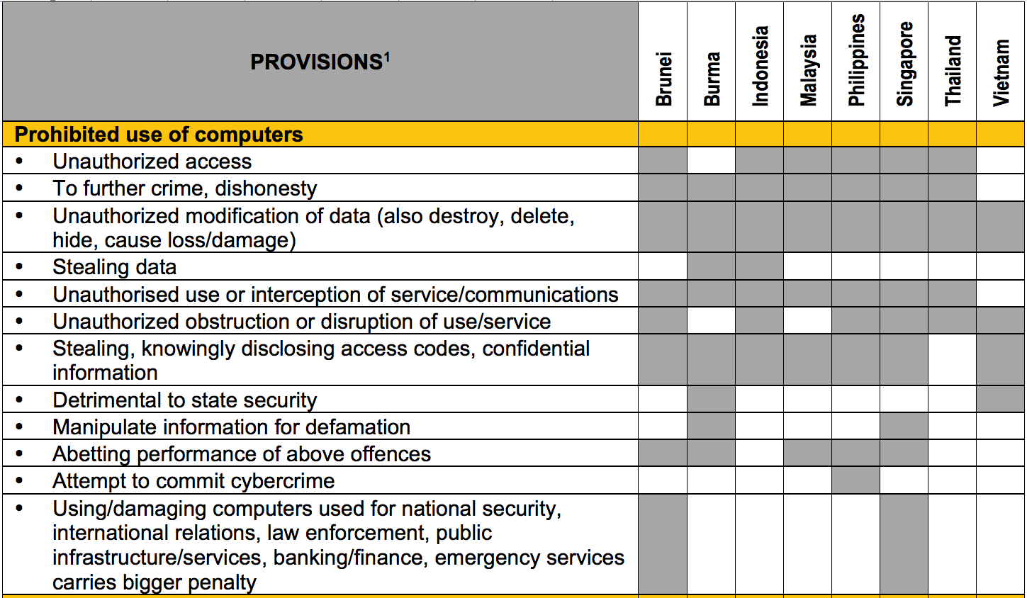

Slide 5
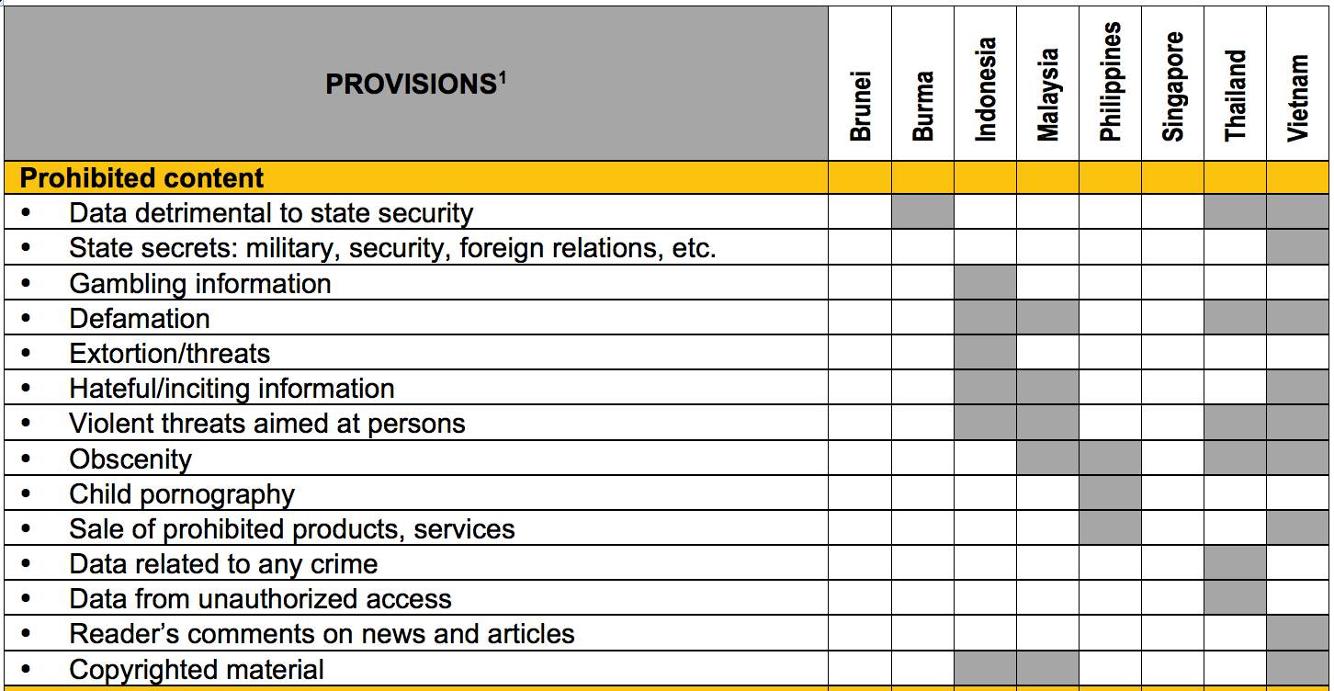

Slide 6
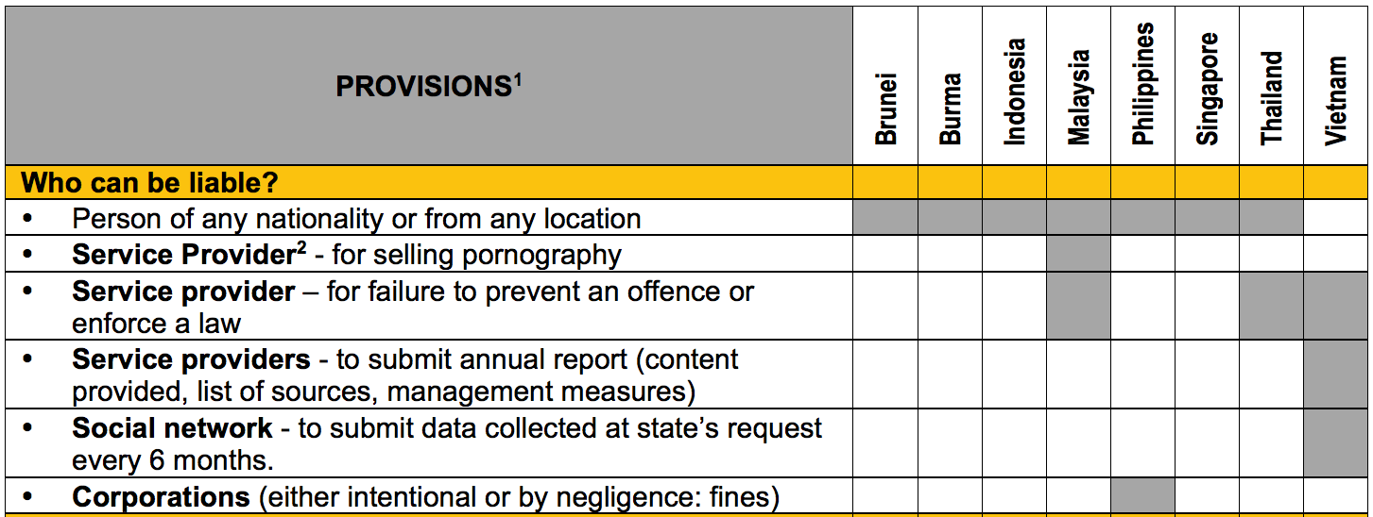

Slide 7
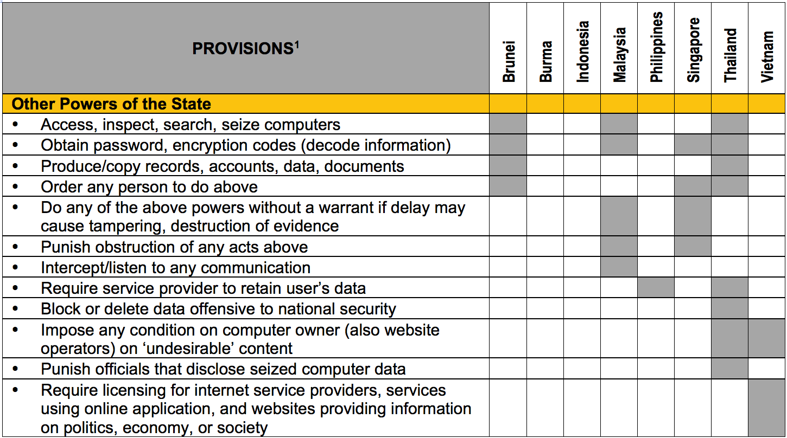

Slide 8
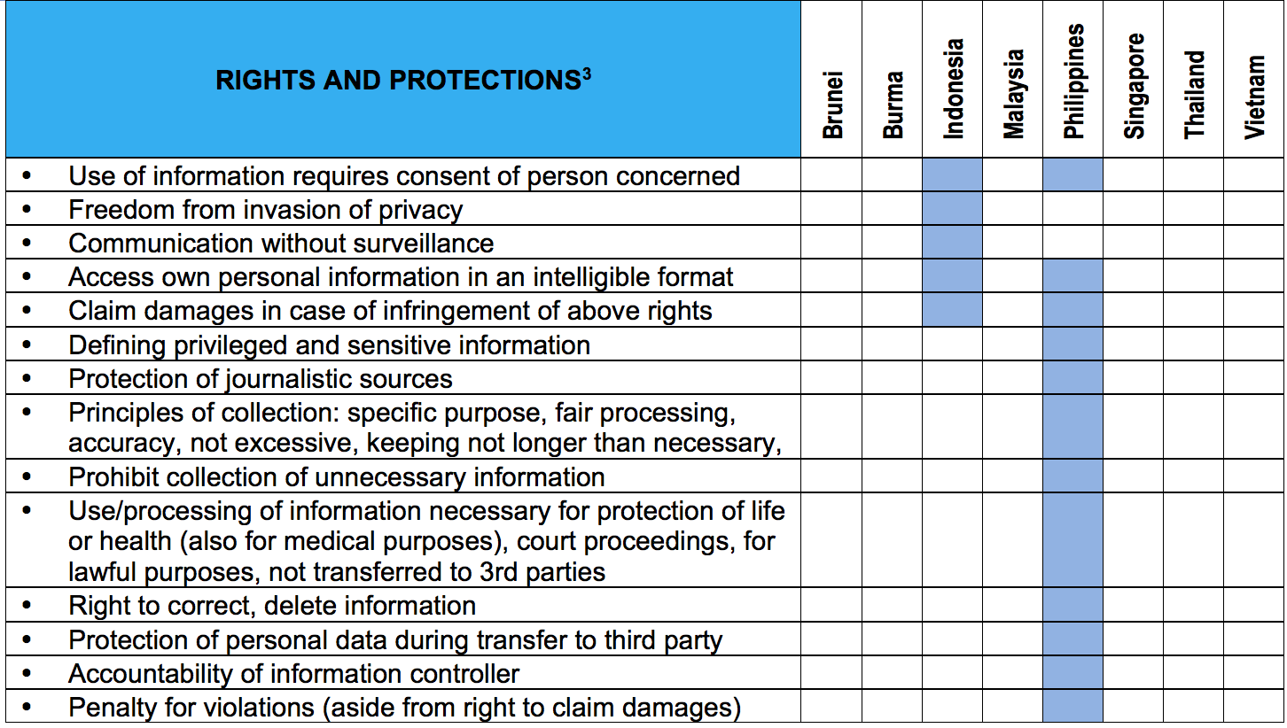

Slide 9
Observations
Regulatory laws are in place - predominantly for restriction not for protection (rights)
In most cases, laws make online acts for existing offline offences punishable
Culpability: persons outside territory; intermediaries

Slide 10
The “light touch” country
Does not specify prohibited content
No intermediary liability
Class Licensing, based on content – news reporting
Notes:
<number>

Slide 11
Some directions
Revisit media framework in the light of convergence – everything is digital
* From classification according to medium
to classification according to purpose
Challenge of law enforcement

Slide 12
New media regulation must must be premised on Freedom of Expression:
Everyone has the right to freedom of opinion and expression; this right includes
freedom to hold opinions without interference
to seek, receive and impart information and ideas through any media
and regardless of frontiers.

